Slide 1
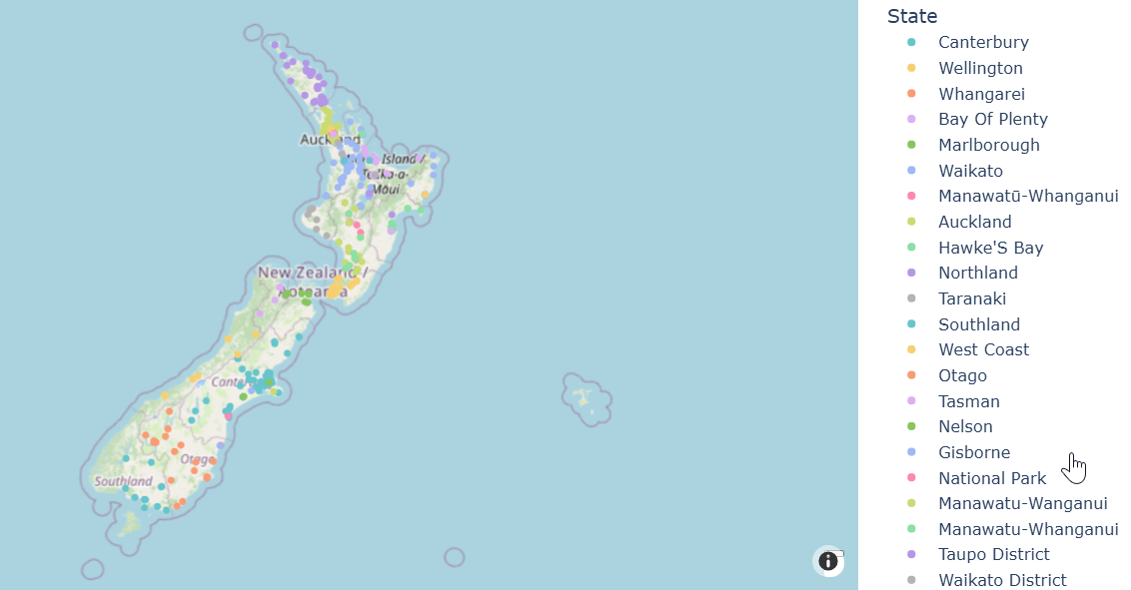
Report – EV Charging Stations in NZ
Turn raw data into gold !
#AI powered Report
#Vibe coding

Slide 2
How is this report created ?
Harnessed the intelligence of LLM and processing power of Python to generate the report.
3 Steps process – That’s all it takes !

Slide 3
Report creation by #AI
STEP 1. Fetched data from API
Used Open Charge Map API for collecting datapoint of –
EV Charging Stations in NZ

Slide 4
Report creation by #AI
STEP 2. Analysed with Python
Used only #Prompts to generate code. #Vibe coding
STEP 3. Published HTML report

Slide 5
TOOLS
GitHub CoPilot
Python
Visual Studio Code

Slide 6
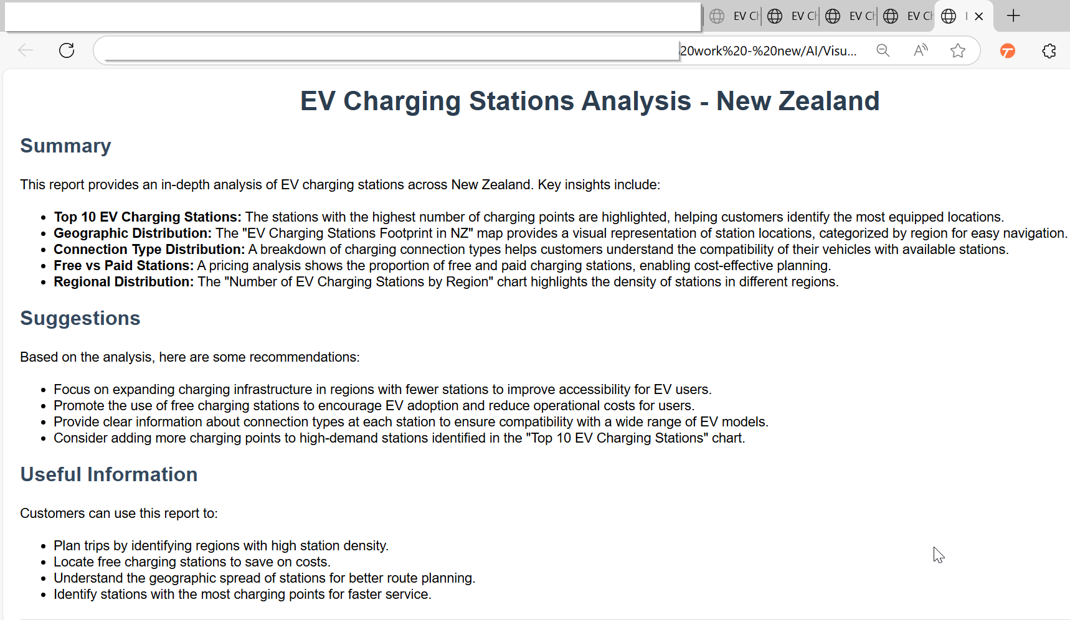
Report

Slide 7
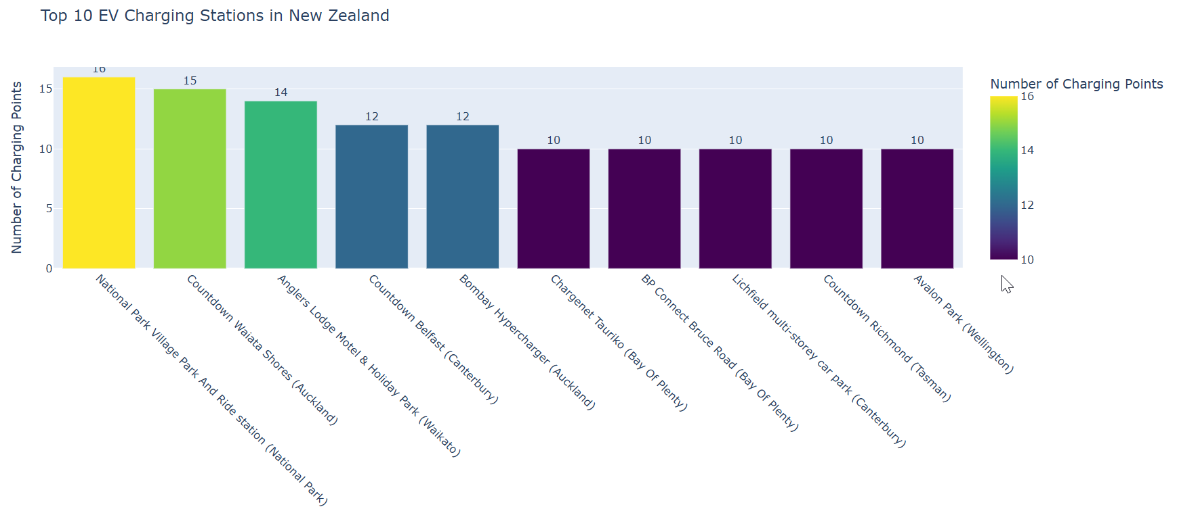
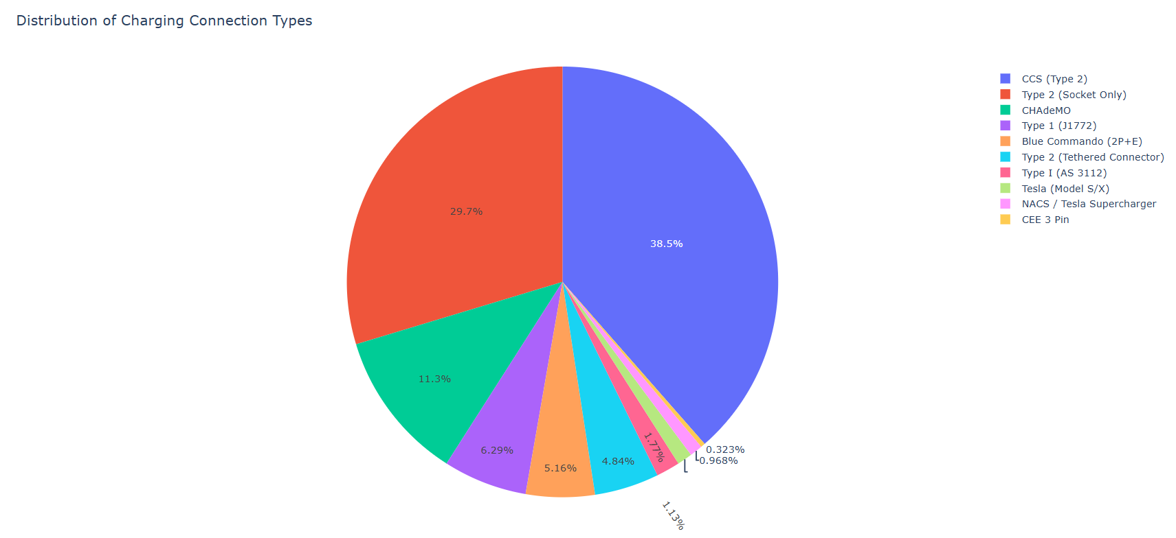
Report
Report
Graph 1 – Top 10 EV stations in NZ
Graph 2 – Connection Type

Slide 8
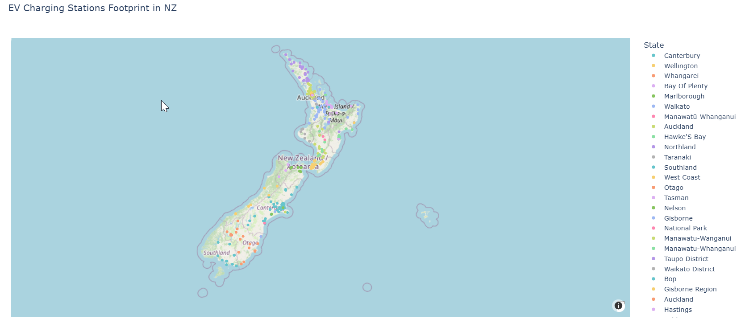
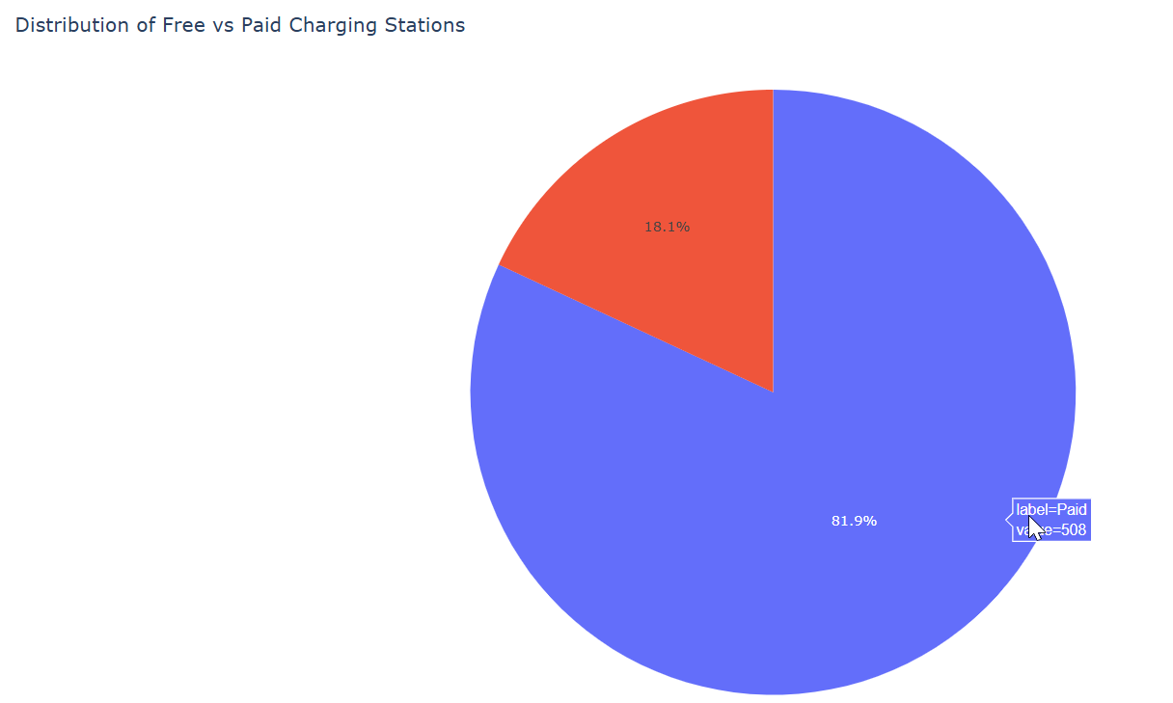
Report
Graph 3 – EV stations footprint in NZ
Graph 4 – Free vs Paid stations

Slide 9
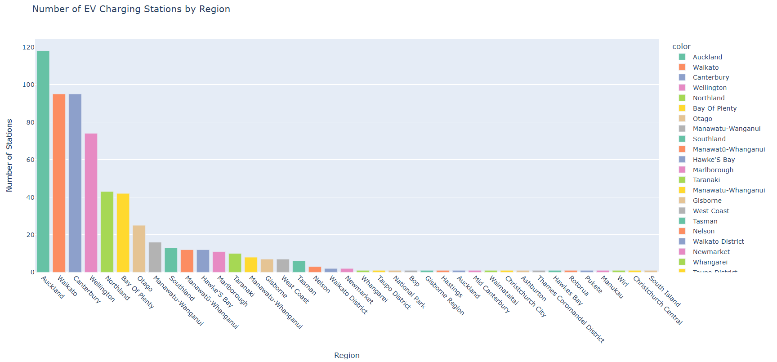
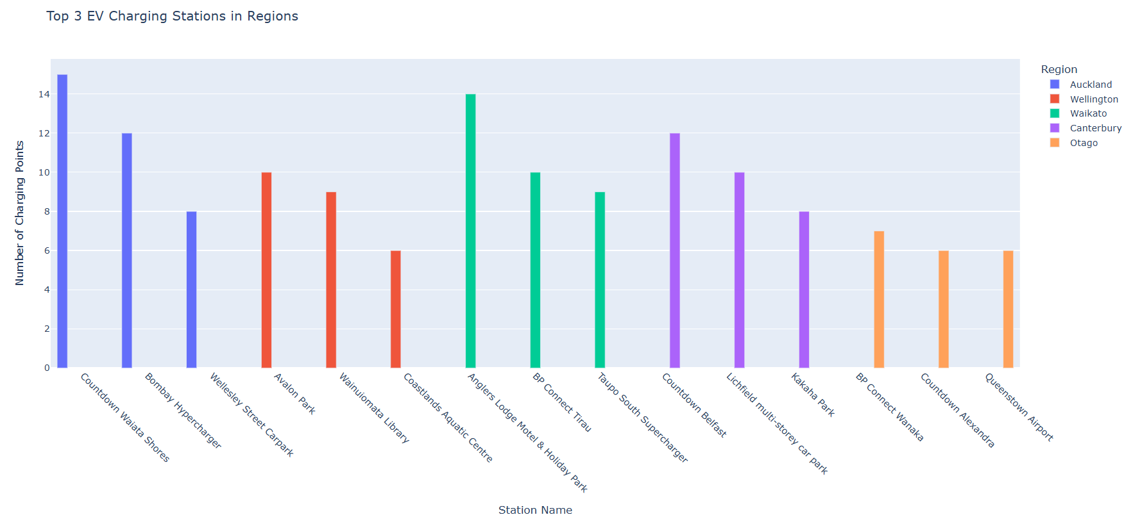
Report
Graph 5 – Total EV stations in Regions
Graph 6 – Top 3 stations in Regions

Slide 10
Highlights of the Report
980
The number of EV charging stations in NZ
INSIGHTS –
Top 10 EV Charging Stations in NZ
Connection Type Distribution
Geographic Distribution
Free vs Paid Stations
Total EV Charging Stations in Regions
Top 3 EV Charging Stations in Regions

Slide 11
Benefits of this report –
Plan trips by identifying regions with high station density.
Locate free charging stations to save on costs.
Understand the geographic spread of stations for better route planning.
Identify stations with the most charging points for faster service.

Slide 12
Transforming data into insights with the brain of #LLMs and the muscle of #Python
#AI powered Reports

